Slide 1
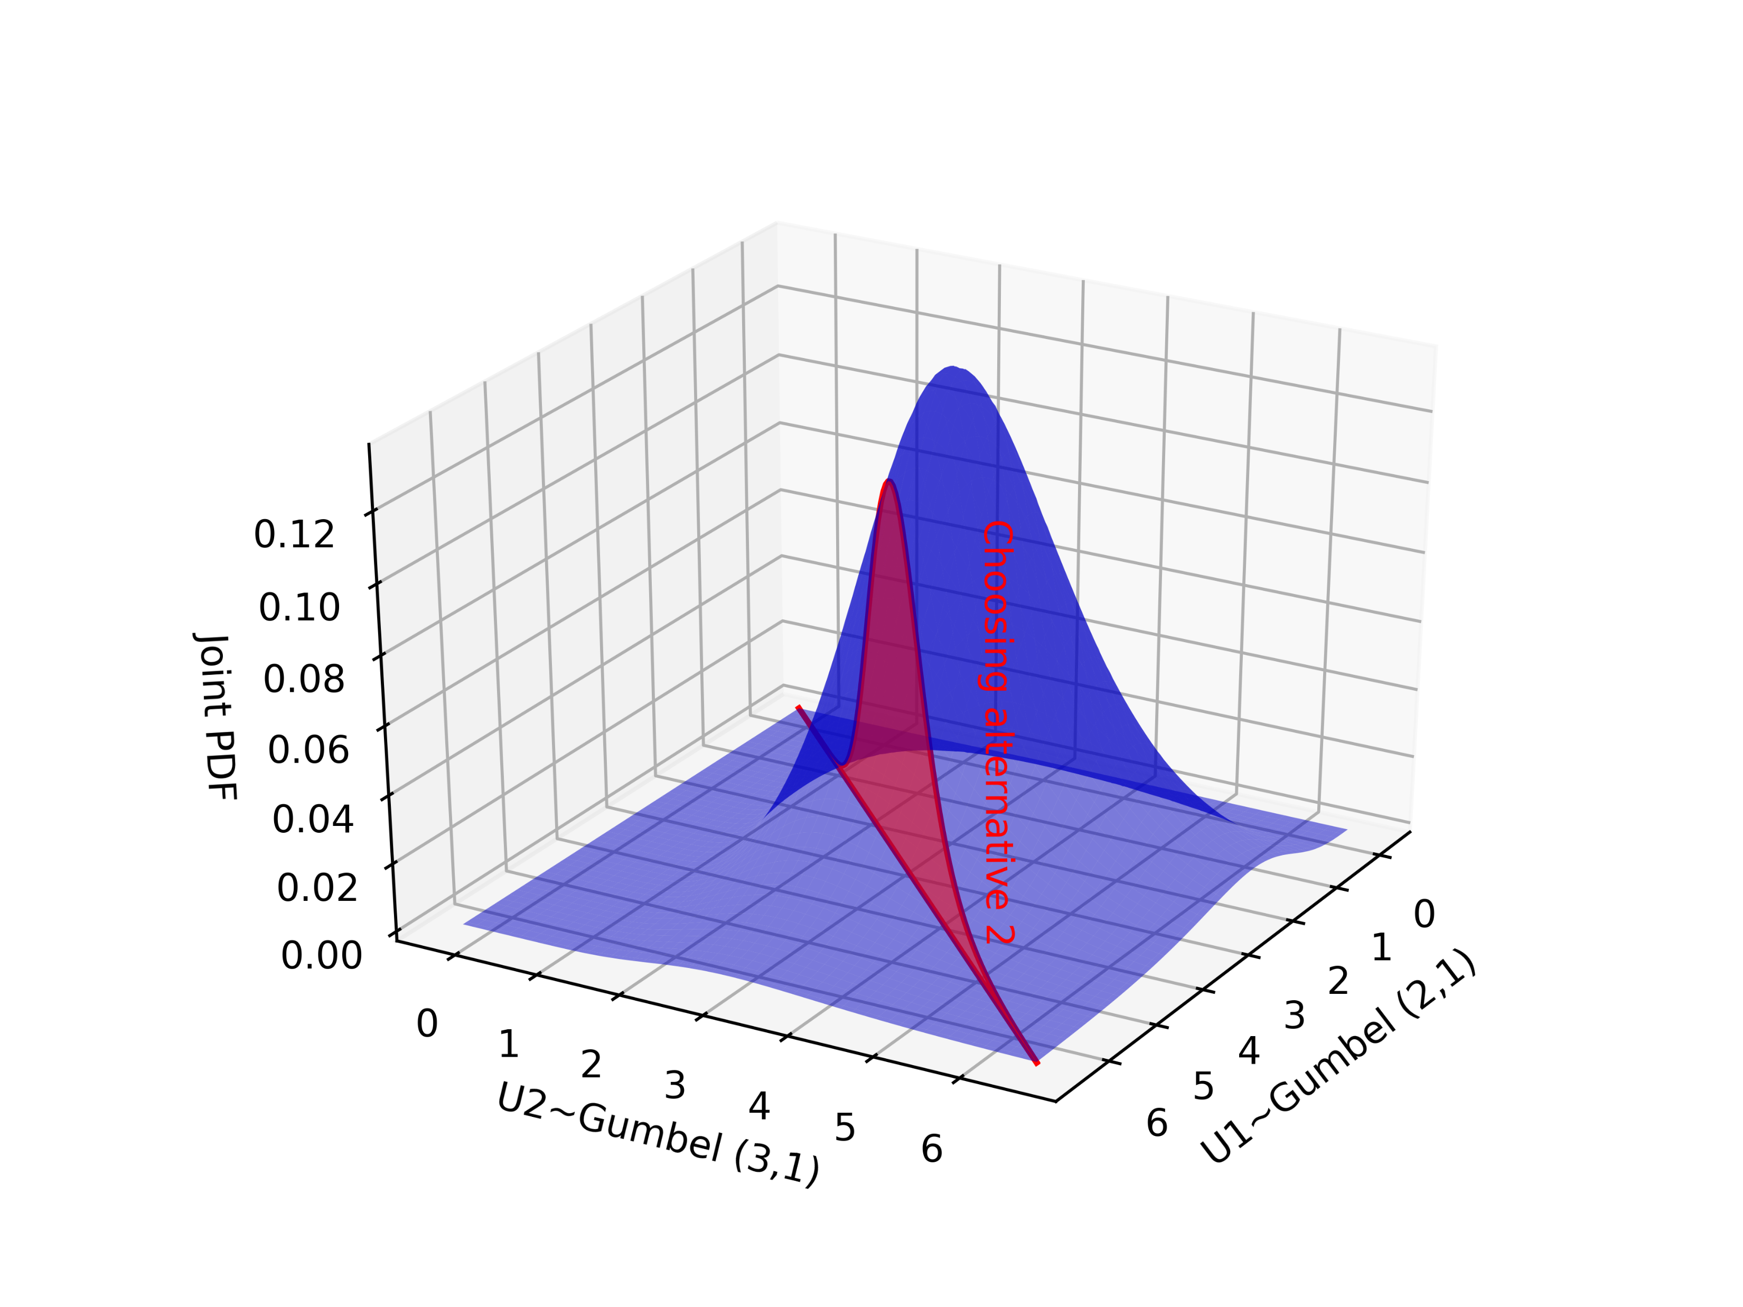
Joint PDF

Slide 2
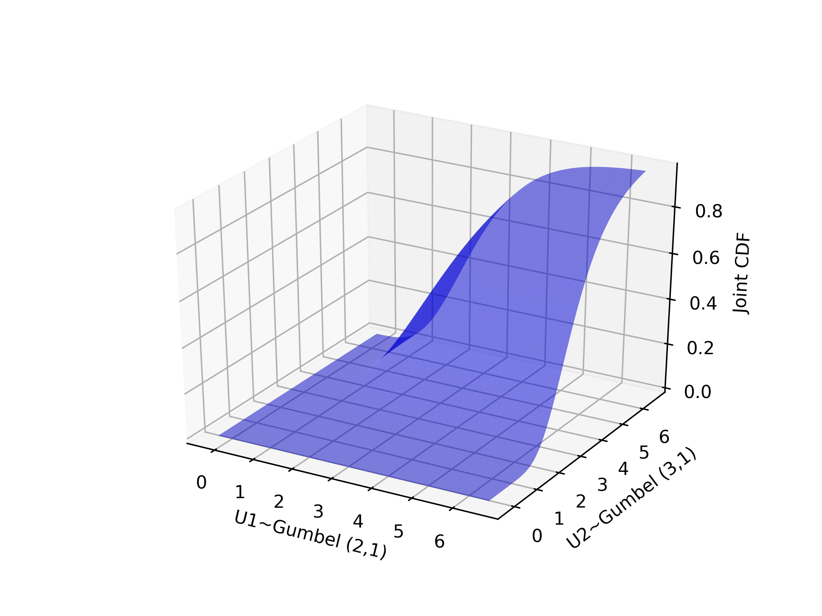
Joint CDF

Slide 3
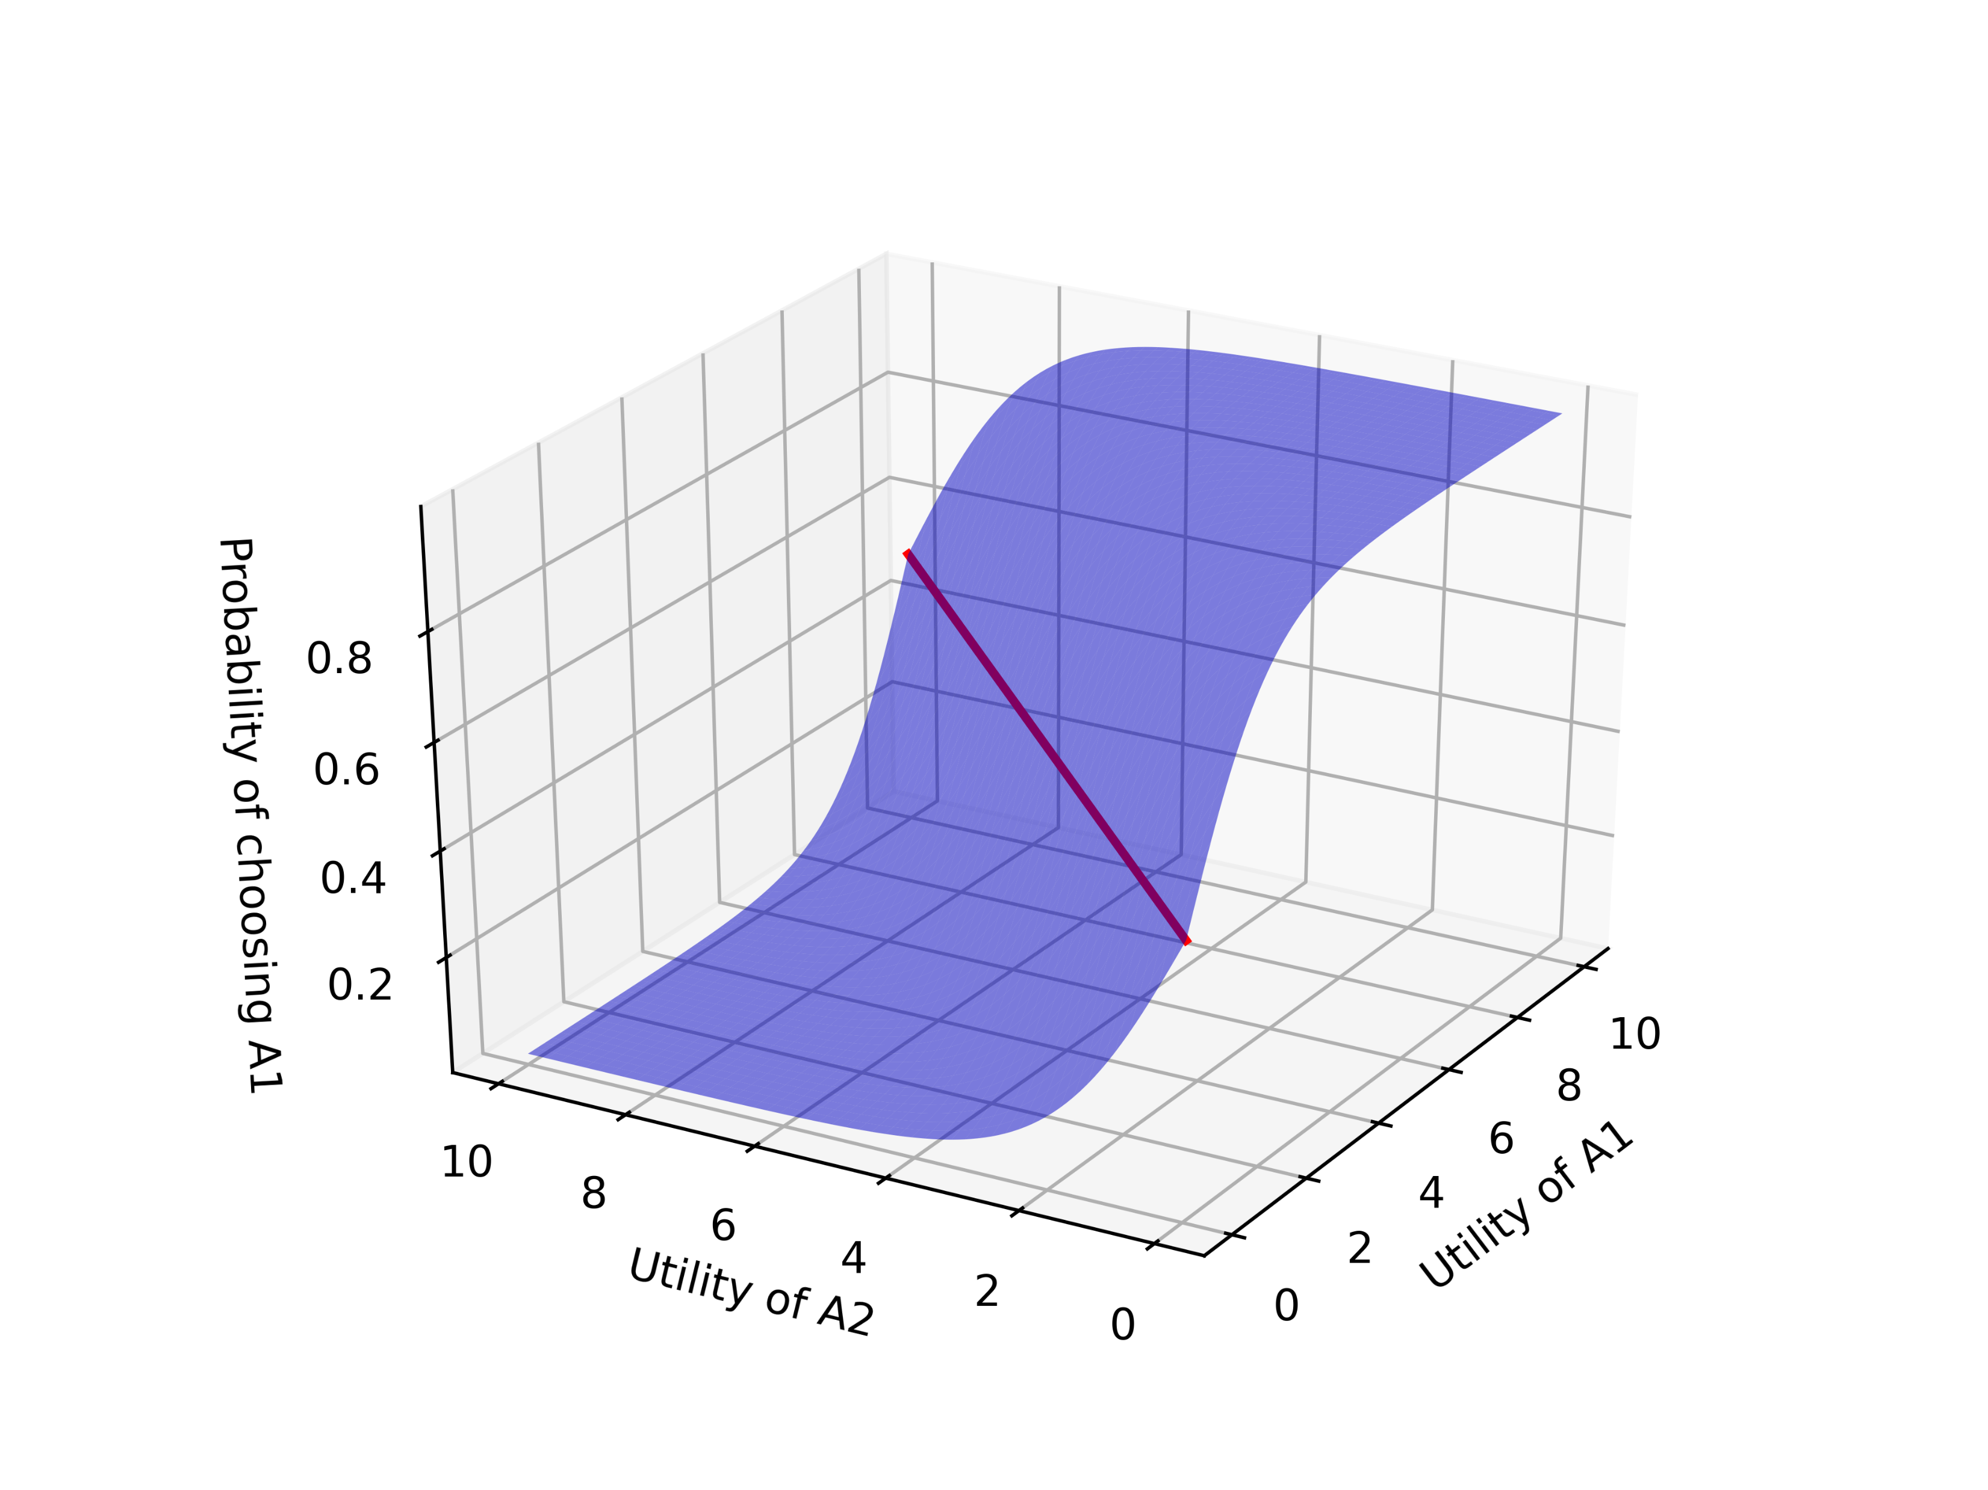
Utility difference and choosing probability
U(A1)=U(A2), P(A1)=0.5

